Slide 1
Experimental Statistics 2
Live Session 2

Slide 2
Pre Live Assignment
Volunteers to Discuss???

Slide 3
Bias Variance Trade OFF
Scenario 1 - Low complexity.
High Bias/Low Variance

Slide 4
Bias-Variance Trade Off
Scenario 2 - Low complexity.
Moderate Bias/Low Variance

Slide 5
Bias-Variance Trade Off
Scenario 3 - Low complexity.
No Bias , Low Variance

Slide 6
Bias-Variance Trade Off Overfitting with K Nearest Neighbors (k=5)
Scenario 4 - High Complexity.
No Bias, Moderately high Variance

Slide 7
Bias-Variance Trade Off Overfitting with K Nearest Neighbors K=2
Scenario 5 - High Complexity ( Even more overfitting).
No Bias, Higher Variance

Slide 8
Bias Variance Trade off
Bias
High Moderate None None None
Low Low Low Moderate High
Variance

Slide 9
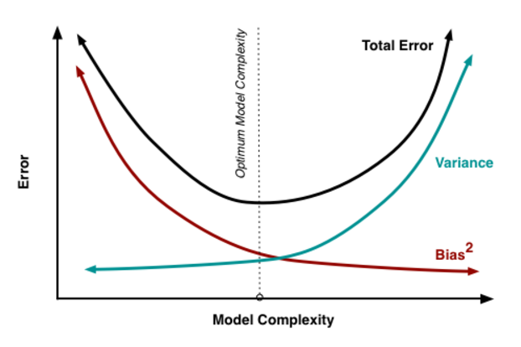
Bias v. Variance v. Model Complexity

Slide 10
A High Level View
Key assumptions:
Normality of residuals
Constant variance

Slide 11
My 2 cents on Model Selection
General Idea
Algorithms that decide which predictors are relevant in a regression model through a sequential procedure using a measure of model fit
Its now becoming more popular to use LASSO, LARS, and ELASTIC NET and use CV to find the “sweet spot” in terms of prediction error (I would use one of these)
It does not need to be the “end all, be all” to your model building process. Think google flu trends.
Drawbacks to (Forward, Backward, Step wise)
Stepwise yield confidence intervals that are too narrow
Computers can’t perform transformations
Correlated predictor effect the frequency in which true predictors are included over predictors that are just random and have no association with the response
Yields models that are too small
Coefficients and statistics are biased
See Ratner for more

Slide 12
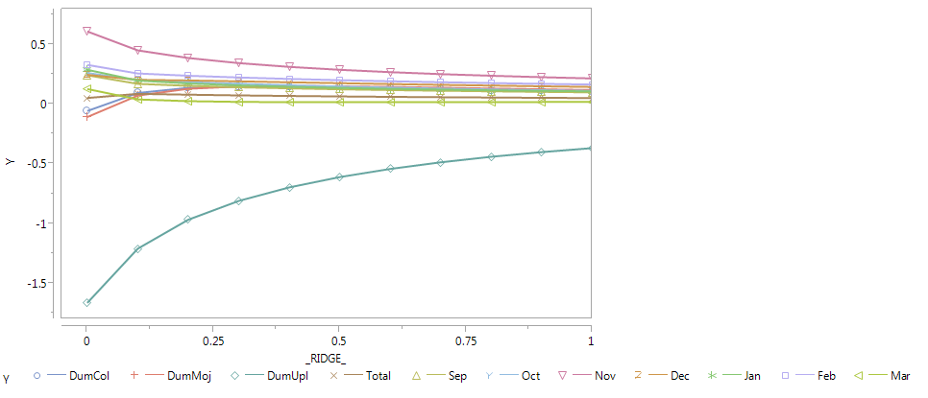
All you need to know about LARS and LASSo mathematically
Methods are a penalized regression technique that forces some coefficients to be 0
X- Axis is the penalty
Y-Axis is the regression coefficients for a given penalty

Slide 13
Cross validation
It is important to be aware that the cross validation covered using glm select is serving a purpose to finding a reduced model with good prediction accuracy.
The Cross validation idea can be done at a much higher level as well if you are trying to assess different approaches and methods (is a Random Forrest outperfroming MLR, knn, etc?)
To do this you want to make sure your ENTIRE modeling process is being included in the cross validation loop.
Estimates to test error are averaged over a number of kfold, bootstrap (random sample with replacement), or randomly selected observations (w/o replacement)

Slide 14
GLM NET (LASSO in R)

Slide 15
Ex: Real World cross validation strategy
Data
Nested Cross validation
Training sample
Training sample
…
Training sample
Stage1 (filter):
correlation, t-test, etc
Stage 2 (design):
Sequential forward search,
Feature selection (LASSO, Random Forest)
+ LDA, SVM,Reg etc
Feature selection &
classifier design
Feature selection &
classifier design
Feature selection &
classifier design
Testing sample
Testing sample
…
Testing sample
Error estimation/Performance
Construction
phase
Summarize performance
Designed classifier based on selected features and full data
Validation Data (independent)
Validated performance
Validation
phase

Slide 16
PROC GLM SELECT
SYNTAX can be a little confusing
It has a data set (training), test set, and validation set (latter 2 are optional)
The data set with no test or validation set specified, then the one data set is for model selection and nothing more. Only internal cross validation can be done to help build the model.
The test set is the “validation” set in the text book. It is the completely independent data set that we can take a look at from an external validation point of view
The validation set is sort of a hybrid in SAS. Depending on the options you pick, the set can be used as part of the model selection procedure (part of the training set), or it could be used essentially as a second independent data set just like the test set.
Why is this important? It is completely possible to overfit to test sets. Having another data set to “validate the validation” can help safeguard.

Slide 17
Scenario 1(Just Training), Scenario 2(Train & Test)
ods graphics on;
proc glmselect data=Wildflower
seed=1 plots(stepAxis=number)=(criterionPanel ASEPlot);
class Region;
model Score = Region Total Sep Oct Nov Dec Jan Feb Mar Year / selection=LASSO(choose=CV stop=AIC) CVdetails ;
run;
quit;
ods graphics off;
ods graphics on;
proc glmselect data=train testdata=test
seed=1 plots(stepAxis=number)=(criterionPanel ASEPlot);
class Region;
model Score = Region Total Sep Oct Nov Dec Jan Feb Mar Year / selection=LASSO(choose=CV stop=AIC) CVdetails ;
run;
quit;
ods graphics off;
External
Internal
Tip: It could be helpful to specify choose and stop to be the same criterion.

Slide 18
Big Picture Discussion

Slide 19
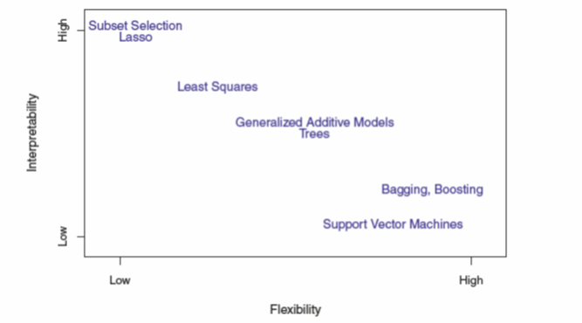
Regression is JUST ONE TOOL

Slide 20
Bias v. Variance v. Model Complexity

Slide 21
Predicting a Continuous Response
Multiple linear regression is just one option in building a predictive model for a continuous response.
It’s a GOOD option when
The true relationship between the response and predictors is “linear” and the model is correctly specified by the modeler.
Sample sizes are small and predictor set is high. More complicated models do not perform well without large sample sizes.
Interpretation of the relationship between the response and key predictors is needed

Slide 22
Building Blocks of MLR

Slide 23
Additional Discussion Points
Multiple linear regression is just one option in building a predictive model for a continuous response.
It’s a BAD option when
The true relationship between the response and predictors is NOT “linear”. The relationships are complex.
You can get close, but you have to work extremely hard in specifying your model.
If the above is true and sample sizes are large, other methods like Random Forests, K-NN, etc will perform better.
They are also less time consuming as model complexity is built in to the algorithm, the user doesn’t have to specify how the relationship exist.

Slide 24
Multiple regression Assumptions
Residuals are normally distributed
(Note the response variable doesn’t necessarily have to be normally distributed, neither do the predictors)
Constant variance – the variance of the residuals does not change depending on the predicted value or any other plot of residuals vs “something”
Observations are independent
Other concerns
Multicollinearity – check through VIFs
This is not an issue if you only want to predict
It’s a major issue if you want to interpret the regression coefficients and assess significance
Outliers and Leverage – check through residual diagnostics

Slide 25
Multiple linear regression Workflow
Summary statistics, scatterplots, boxplots, etc
Outlier detection, transformation of nonlinear trends, removing variables that are unnecessary, redundant, or simply don’t make sense
Model building (Partly depends on the goal, Unit 2.6 & 2.7 is good for this)
Including key predictors of interest and other potential variables that could contribute
For many predictors use a selection approach
Assumption checking, residual diagnostics, checking model fit, multicollinearity
Possibly repeat 2-3 as needed to address issues
Note: If you reduce your model based on individual t-tests, those t-tests are only valid if the assumption are appropriate

Slide 26
Multiple linear regression Workflow
Hypothesis testing
High level: Overall F-tests (Null: All coeffs are 0)
Low level: Individual t-tests
Interpretation of regression coefficients, CI’s
When predictors are uncorrelated
For a 1 unit increase in X there is a β increase in the response holding the other predictors fixed
When predictors are correlated
Its harder to come up with a nice statement because you can’t hold the other predictors fixed because when one goes up the others must go up or down because they are correlated
One way to describe this situation is just to refer that the particular predictor is statistically significant after adjusting for the other predictors in the model. Then provide a CI for the regression coefficient.
Basic Confidence interval statement
We are 95% confident that the true regression coefficient β for predictor X is between (lower limit, upper limit).

Slide 27
Multiple linear regression Workflow
Providing predicted values and prediction intervals
To do this in SAS all you need to do is include the values you want to predict at the end of your data set with a missing value “.” for the response. Option in SAS to print the result is CLI.
Include any concerns or faults with the analysis as currently conducted.
If your data set is big enough, always leave some data out for a validation set or conduct a k-fold cross validation to assess over fitting concerns.
Important Note: It is possible to over fit a test set. If you are using the test set to help decide what model is best, you have technically not “validated” your model. You would need a new data set to to then see how your model performs. (Why I don’t like kaggle competitions. Promotes bad habit that is often lost to the competitor desperate to improve their score.

Slide 28
GOLF DATA SET
Refresher of the general workflow.

Slide 29
GolF data set
Professional golfers from a particular year
Salary variables (Potential responder variables): Total Winnings, Avg Winnings, MoneyRank
Player Stats (Potential predictors):
Age, AvgDrive, DriveAcc, Greens, AvgPutts, Save Percentage, # of Events played

Slide 30
Goals That I defined for the Analysis
It would be interesting to see that after adjusting for Age and total # events played, does ball striking, putting, or both have the ability explain the variability within Players earnings (I’m going to go with average salary per event as this indicates a consistent player versus a guy getting lucky winning a major and inflating his total from just one win)
There is a saying “Drive for show, put for dough”. We can use this data set to see if that really is the case.
Although this particular data set you might not care about predicting. Depending on if this is a goal or not we might do make some slight changes at the end of the analysis. I will discuss it then.

Slide 31
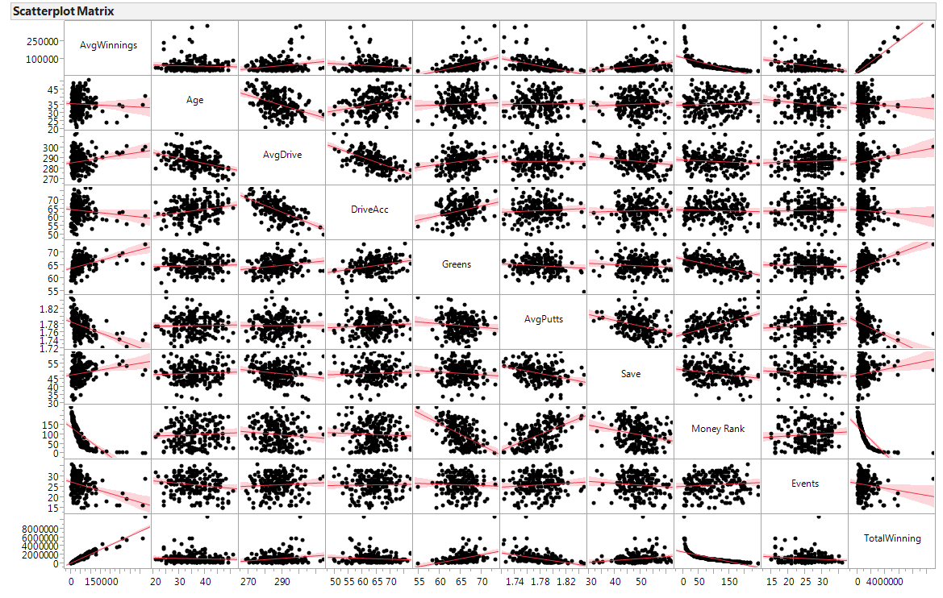
Plot that Data

Slide 32
Comments
I’m not going to use Total Earnings and Money Rank as they are both essentially different ways to measure income.
Of course there is strong relationship there but those variables as predictors aren’t useful or interesting

Slide 33
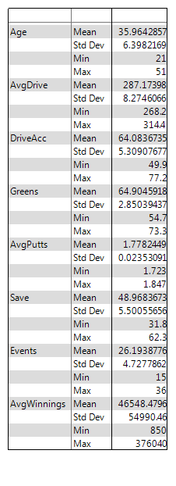
Summary stats
Like I mentioned, there is no assumption of normality of the predictors or the response (only the residuals)
Summary stats serve as a sanity check. Do the summaries make sense for that variable? Is the min and max reasonable or not what is expected? These can help catch possible programming issues, data generation, outliers, etc.

Slide 34
Fit the full model (OR Feature Selection) Take a look at VIF’s
Parameter Estimates
Variable | DF | Parameter Estimate | Standard Error | t Value | Pr > |t| | Variance Inflation
Intercept | 1 | 945580 | 305887 | 3.09 | 0.0023 | 0
Age | 1 | -587.12529 | 519.32406 | -1.13 | 0.2597 | 1.25413
AvgDrive | 1 | -94.76127 | 567.41935 | -0.17 | 0.8675 | 2.50410
DriveAcc | 1 | -2360.56944 | 854.02065 | -2.76 | 0.0063 | 2.33519
Greens | 1 | 8466.03572 | 1303.86824 | 6.49 | <.0001 | 1.56901
AvgPutts | 1 | -694226 | 138156 | -5.02 | <.0001 | 1.20051
Save | 1 | 1395.66667 | 587.53879 | 2.38 | 0.0185 | 1.18641
Events | 1 | -3159.22407 | 644.24244 | -4.90 | <.0001 | 1.05381

Slide 35
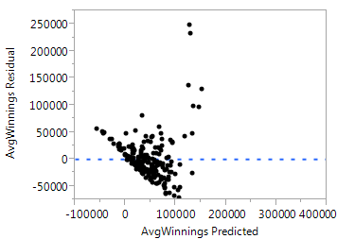
Residual Diagnostics Residual vs Predicted

Slide 36
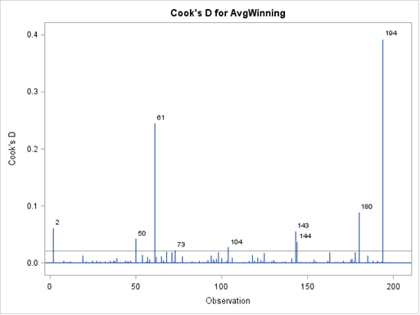
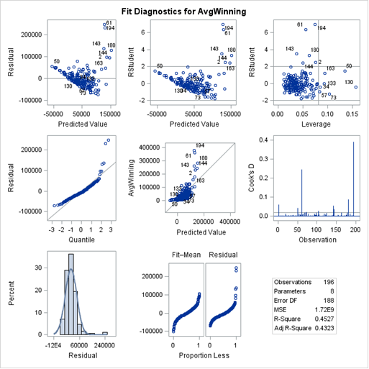
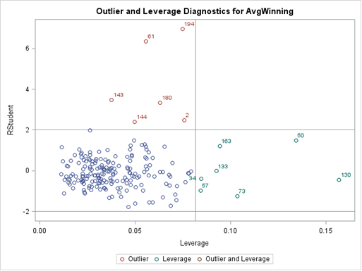
Residual Diagnostics

Slide 37
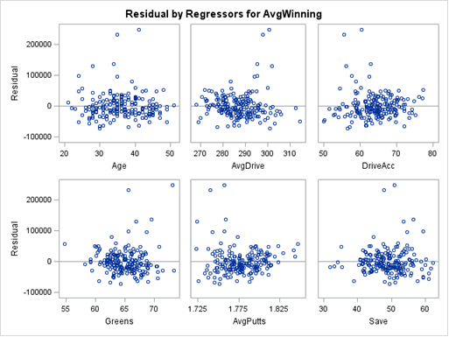
Residual Diagnostics Residuals vs the Predictor Variables

Slide 38
Recap
We look okay on multicollinearity
Nonconstant Variance is my main concern here as it does the cone shape thing
Residuals vs predictors show no apparent patterns
My thought - is to try to transform the response by taking the log. When variance increases as predicted values increase a log transformation typically does the trick. Go back and add a new variable called logAvgWinnings

Slide 39
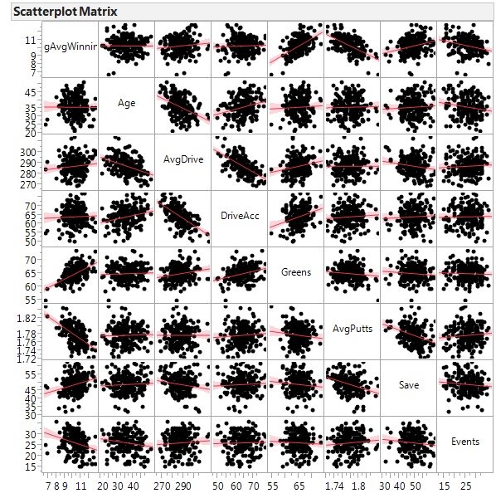

Slide 40
Note that the VIF’s haven’t changed from before. The formula has nothing to do with the response variable as it is trying to capture how the predictors are related to each other
Parameter Estimates
Variable | DF | Parameter Estimate | Standard Error | t Value | Pr > |t| | Variance Inflation
Intercept | 1 | 33.83132 | 4.48200 | 7.55 | <.0001 | 0
Age | 1 | -0.00822 | 0.00761 | -1.08 | 0.2817 | 1.25413
AvgDrive | 1 | -0.00611 | 0.00831 | -0.73 | 0.4634 | 2.50410
DriveAcc | 1 | -0.02049 | 0.01251 | -1.64 | 0.1031 | 2.33519
Greens | 1 | 0.19038 | 0.01910 | 9.97 | <.0001 | 1.56901
AvgPutts | 1 | -18.45737 | 2.02433 | -9.12 | <.0001 | 1.20051
Save | 1 | 0.02700 | 0.00861 | 3.14 | 0.0020 | 1.18641
Events | 1 | -0.03975 | 0.00944 | -4.21 | <.0001 | 1.05381

Slide 41
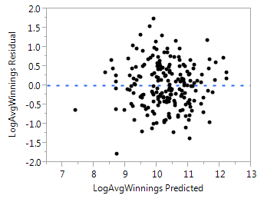
Residual versus Predicted

Slide 42
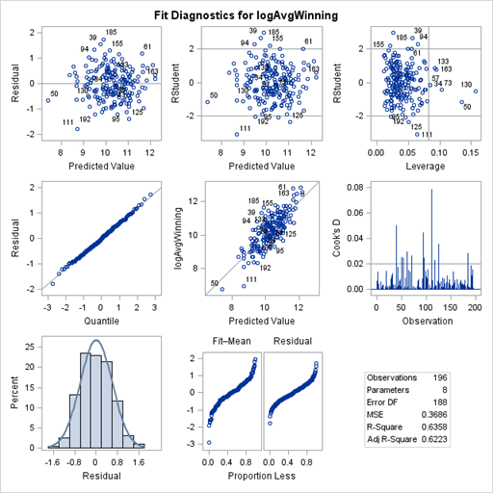
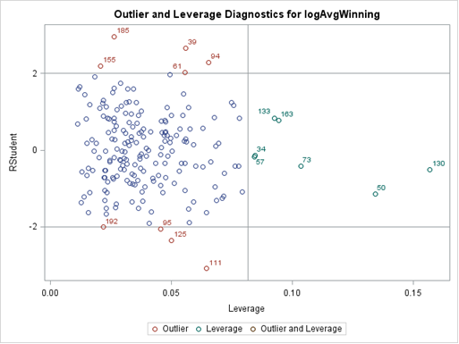
Residual Updates

Slide 43
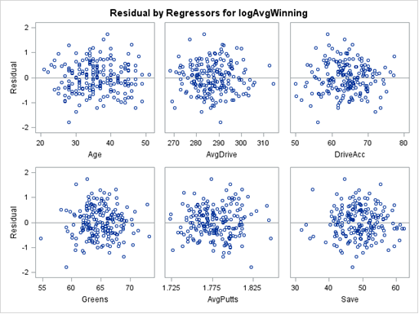
Residual vs Predictor Variables

Slide 44
To Answer My question
Are driving and putting statistics associated with player earnings after adjusting for events and age?
To answer this question, since my residuals are solid now, I can move forward with hypothesis testing.
Some analysts might perform the individual tests and remove the nonsignificant terms. To answer the question though, to me, I will leave them in to do the hypothesis testing and reporting.
In addition to my question, if I wanted to report a final model so folks can do prediction I would then remove them and fit a smaller model with the insignifcant ones removed and provide ALL my results on the reduced model.

Slide 45
Overall F-test
Analysis of Variance
Source | DF | Sum of Squares | Mean Square | F Value | Pr > F
Model | 7 | 120.97465 | 17.28209 | 46.89 | <.0001
Error | 188 | 69.28954 | 0.36856
Corrected Total | 195 | 190.26419
Null hypothesis: All of the regression coefficients are equal to 0
Alternative: At least one is not 0.
Conclusion. Using a significance threshold of 0.05, we reject the null hypothesis in favor of the alternative that there is at least one regression coefficient different from 0 (pvalue <.0001).

Slide 46
One at a time t-tests
Parameter Estimates
Variable | DF | Parameter Estimate | Standard Error | t Value | Pr > |t| | Variance Inflation | 95% Confidence Limits
Intercept | 1 | 33.83132 | 4.48200 | 7.55 | <.0001 | 0 | 24.98984 | 42.67280
Age | 1 | -0.00822 | 0.00761 | -1.08 | 0.2817 | 1.25413 | -0.02323 | 0.00680
AvgDrive | 1 | -0.00611 | 0.00831 | -0.73 | 0.4634 | 2.50410 | -0.02251 | 0.01029
DriveAcc | 1 | -0.02049 | 0.01251 | -1.64 | 0.1031 | 2.33519 | -0.04518 | 0.00419
Greens | 1 | 0.19038 | 0.01910 | 9.97 | <.0001 | 1.56901 | 0.15269 | 0.22807
AvgPutts | 1 | -18.45737 | 2.02433 | -9.12 | <.0001 | 1.20051 | -22.45069 | -14.46404
Save | 1 | 0.02700 | 0.00861 | 3.14 | 0.0020 | 1.18641 | 0.01002 | 0.04398
Events | 1 | -0.03975 | 0.00944 | -4.21 | <.0001 | 1.05381 | -0.05838 | -0.02113
Player statistics involving the players short Greens hit, Avg # of putts, and save percentage are all statistically significant at the 0.05 significance level after adjusting for all the remaining variables. Drive Accuracy and Avg Drive Distance are not statistically significant after adjusting for the other variables. This analysis supports the motto “Drive for Show, putt for dough $$$”.

Slide 47
Reporting CI’s and additional insight
In a report you do not necessarily have to provide interpretation and wording for every regression coefficient, you can just refer to a table.
If there is a variable of particular interest or you know someone might ask you a question to help them understand what that regression coefficient means in layman's terms, then you can provide it for the ones that make sense.

Slide 48
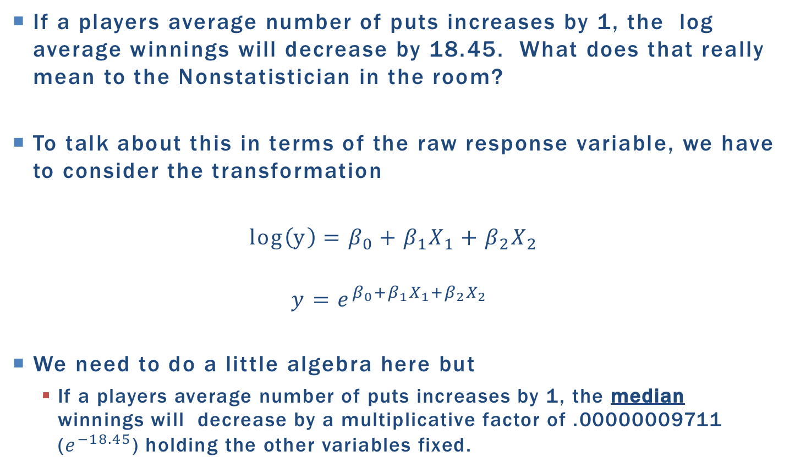
Interpret the regression coefficients when we transformed Y
If a players average number of puts increases by 1, the log average winnings will decrease by 18.45. What does that really mean to the Nonstatistician in the room?
To talk about this in terms of the raw response variable, we have to consider the transformation
$log\left(y\right)=β_{0}+β_{1}X_{1}+β_{2}X_{2}$
$$y=e^{β_{0}+β_{1}X_{1}+β_{2}X_{2}}$$
We need to do a little algebra here but
If a players average number of puts increases by 1, the median winnings will decrease by a multiplicative factor of .00000009711 ($e^{−18.45}$) holding the other variables fixed.

Slide 49
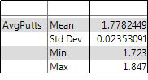
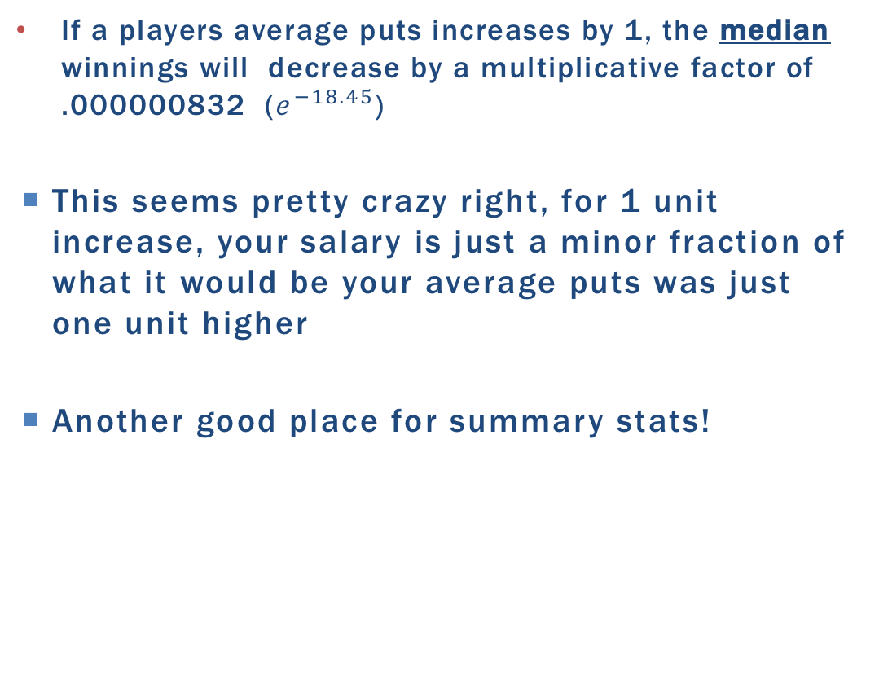
Does a 1 Unit increase Make Sense?
If a players average puts increases by 1, the median winnings will decrease by a multiplicative factor of .000000832 ($e^{−18.45}$)
This seems pretty crazy right, for 1 unit increase, your salary is just a minor fraction of what it would be your average puts was just one unit higher
Another good place for summary stats!

Slide 50
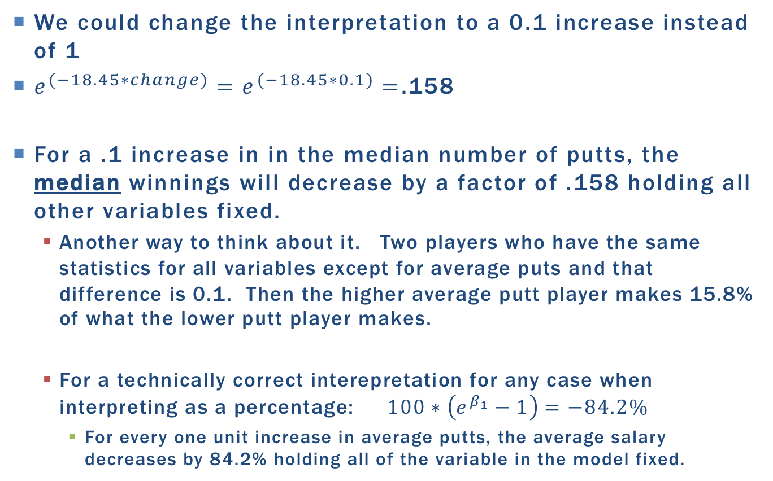
We could change the interpretation to a 0.1 increase instead of 1
$e^{(−18.45∗change)}=e^{(−18.45∗0.1)}=$.158
For a .1 increase in in the median number of putts, the median winnings will decrease by a factor of .158 holding all other variables fixed.
Another way to think about it. Two players who have the same statistics for all variables except for average puts and that difference is 0.1. Then the higher average putt player makes 15.8% of what the lower putt player makes.
For a technically correct interepretation for any case when interpreting as a percentage: $100∗\left(e^{β_{1}}−1\right)=−84.2\%$
For every one unit increase in average putts, the average salary decreases by 84.2% holding all of the variable in the model fixed.

Slide 51
For this class, I encourage students if they make transformations to try to interpret things back on the original response
It just takes a little bit of care and thought. If you are not convinced that you have it correctly, of course discuss with me, or just provide the standard interpretation on the transformed scale.

Slide 52
Good rules of thumb on residuals plots
If the variance is not constant – transform y
If there are patterns
transform x’s
add higher order polynomials
add complexity through interactions

Slide 53
Final thoughts
Important to remember that model selection is not a fix all
Read Ratner paper as he talks about a good general strategy for EDA as well as Unit 2.6 and beginning of 2.7.
You have to make calls about certain variables, transformations, adding quadratic terms, interactions, validity of the assumptions. The automated procedures can’t do that.
If your data has a ton of predictors and you need a way to narrow it down, model selection up front can be helpful. Don’t forget to consider model complexity before feature selection, especially with lots of data.
If you have lots of data think about external validation by subsetting your data into a model building data set and use the additional one to assess how well your model performs on new data.
Another way to use model selection is to manually build your model and see if model selection criterions generally agree.

Slide 54
Unit 3 Content
3.5 Additive Model 3.10 provides a view of the difference between additive and nonadditive(interactions) (Textbook Section 13.2 is a good read for this as well.)
3.6 Overall F-tests (the “big picture” part that we will be building on during live session is at the end of the video during the summary.)
3.8 Examples of how two way anovas can come about
CRD completely randomized designs
RCB randomized complete blocks
Recall that our example studies that I had you guys get into groups were already set up to be RCB or the preferred way to run the study would be to do a RCB.
3.9 Discussion on contrasts creates the most confusion. We will dive into this in more detail with a less complex example to illustrate this.
3.10 See 3.5 above, this also covers multiple testing which is a must watch discussion.

Slide 55
SAS recap
Multiple Regression
PROC REG : all predictors must be numeric, categories must be made into dummy variables
PROC GLM : does the dummy variable transformation for you so categories can be used as is. Some options have changed. For example instead of getting VIF’s you have to specify the option TOLERANCE which gives you a value of 1/VIF
Model Selection
PROC GLMSELECT: allows for all the various model selection approaches, can do both internal and external cross validation
The HW is going to focus on a comparison of the LASSO and OLS regression estimates in terms of prediction (rather than feature selection)

Slide 56
Using residuals to add complexity of continuous predictors

Slide 57
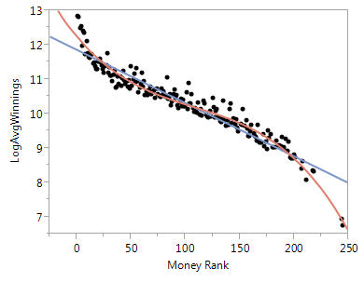
How to know when to include polynomial terms

Slide 58
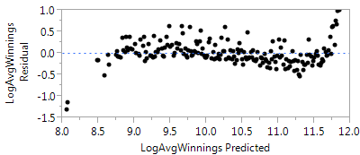
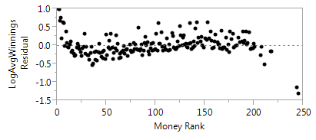
Residuals of the linear fit will have patterns in the residual plots. Note the variance is constant just not a band around 0.

Slide 59
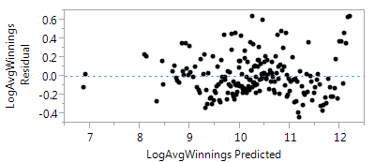
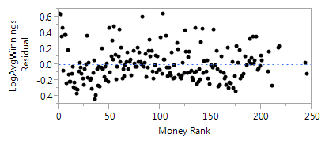
After including a squared and a cube term

